Slide 1
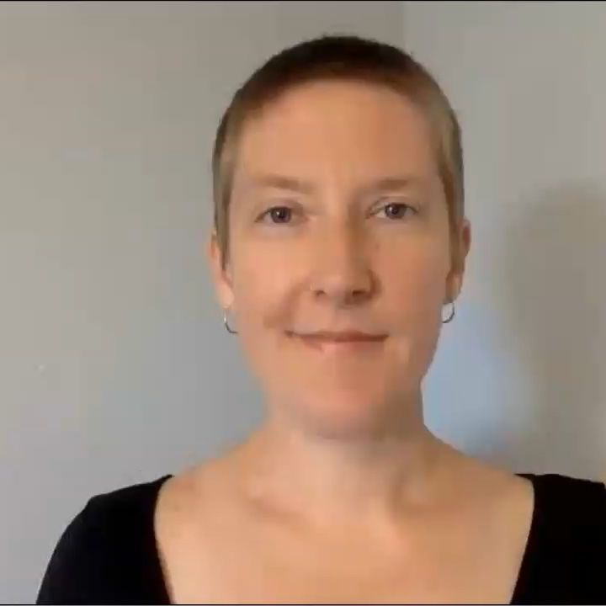
Courage
(environmental style)
Rachel Fredericks, PhD
(she / they)
www.rachelfredericks.com

Slide 2
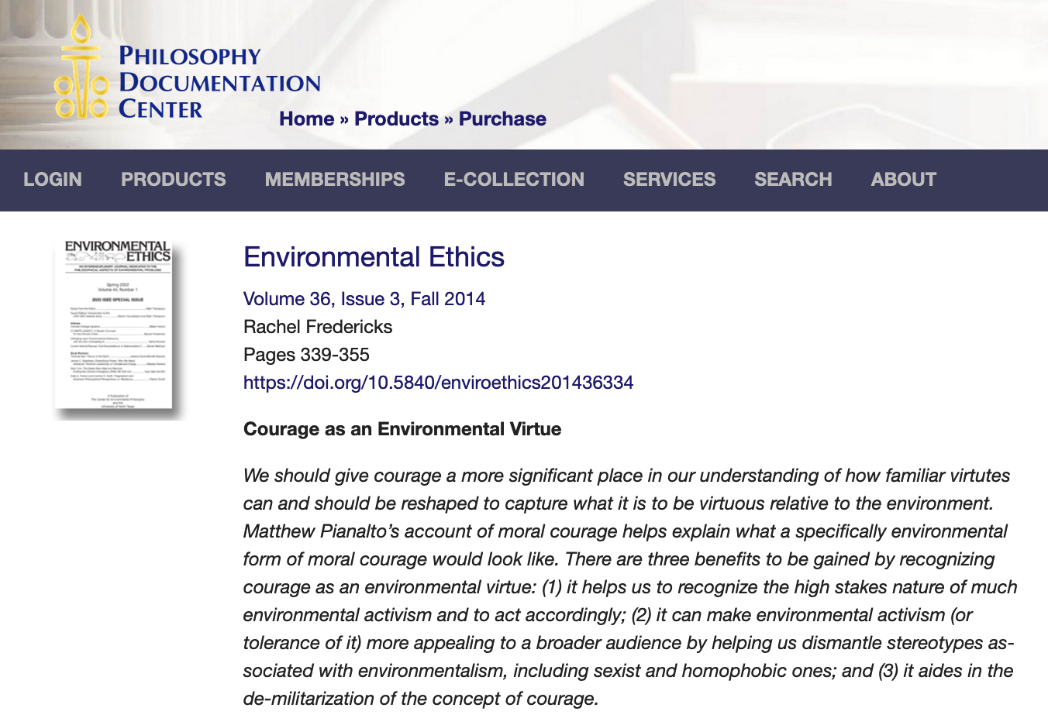
Philosophy Documentation Center: “Courage as an Environmental Virtue”

Slide 3
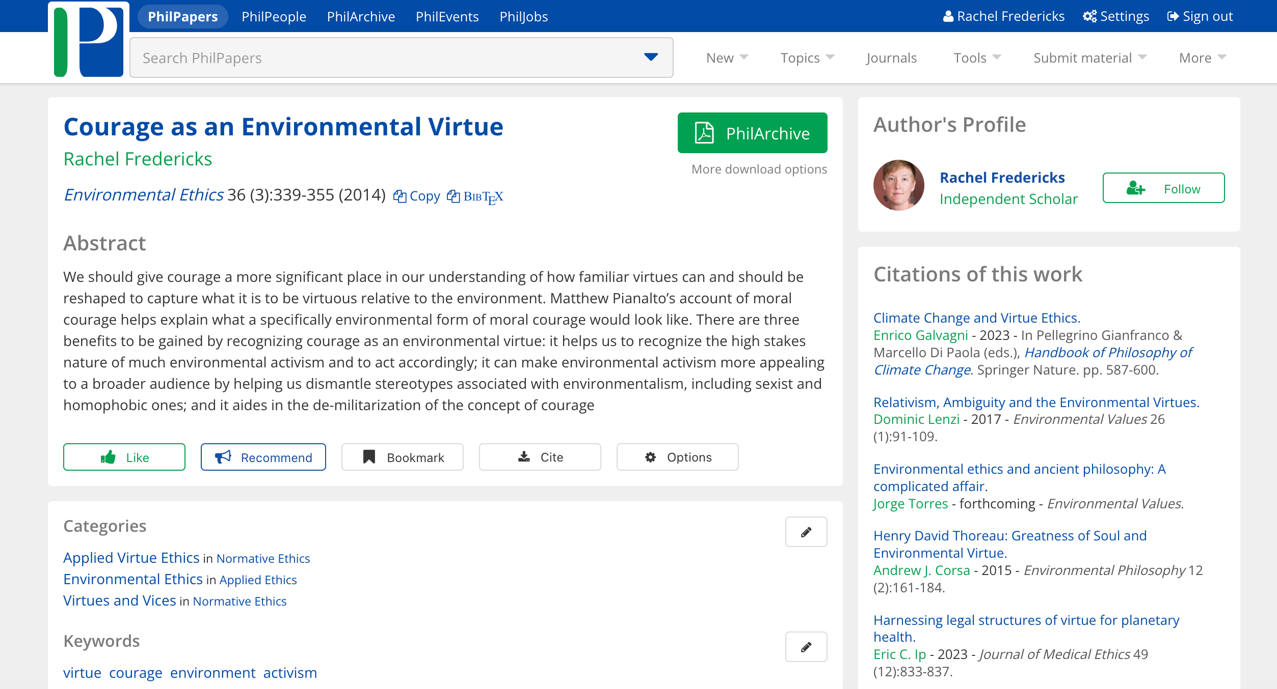
Free copy of paper available at: https://philpapers.org/rec/FRECAA

Slide 4
a VIRTUE is
a form of excellence
or
a character trait that helps us flourish
or
a good way of perceiving, thinking, feeling, and acting
or
the opposite of a vice
or
...

Slide 5
Examples of (some) virtues – randomly arranged
integrity
wonder
justice
trust
love
cooperation
honesty
generosity
respect
loyalty
(some)
VIRTUES
mercy
wit
simplicity
flexibility
humility
purity
creativity
compassion
reverence
care
tact
strength
gratitude
decisiveness

Slide 6
Virtues Most Often Discussed by Environmental Virtue Ethicists - randomly arranged
love
wonder
Virtues most often discussed by environmental virtue ethicists
justice
respect
mercy
simplicity
humility
compassion
reverence
care
gratitude

Slide 7
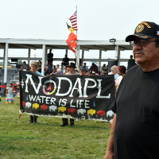

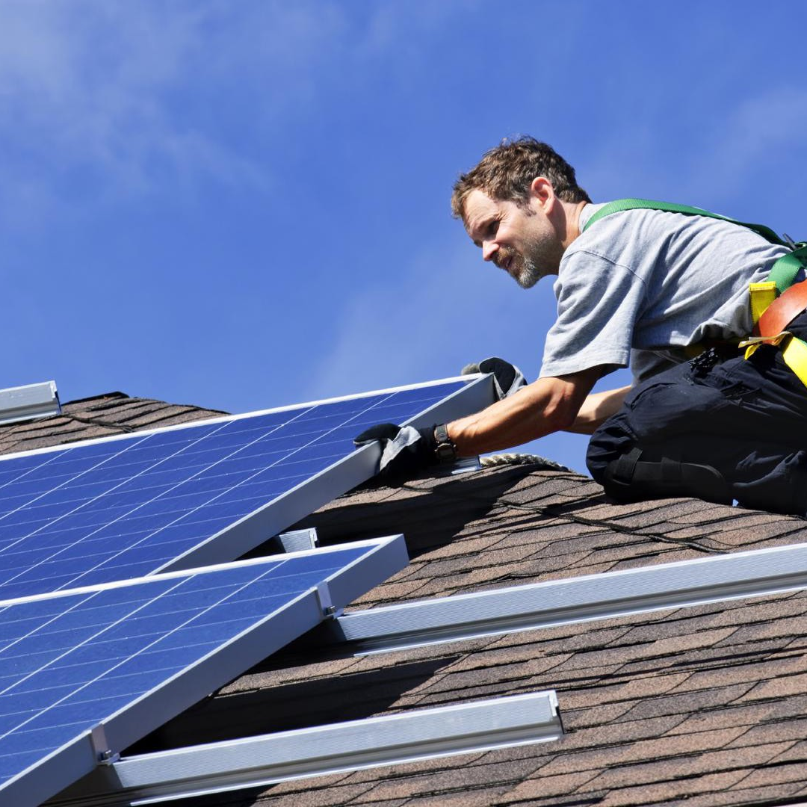
But some conflict is inevitable.
So, we need ACTION to solve pressing environmental problems!
(Better attitudes alone won’t cut it.)
This Photo by Unknown Author is licensed under CC BY-SA-NC
Raya Salter, lawyer and energy policy expert
(FRANCIS CHUNG/EENEWS/POLITICO/AP)
This Photo by Unknown Author is licensed under CC BY

Slide 8

There is a major disconnect between many people’s self-reported attitudes and their actions relative to the environment.
This Photo by Unknown Author is licensed under CC BY-ND

Slide 9
Possible (Partial) Explanations
Many people:
have more concerns than they can possibly act on,
don’t know how to act on their environmental concerns, or
don’t believe that individual actions can make much or any difference.
This Photo by Unknown Author is licensed under CC BY-ND

Slide 10
One More (Partial) Explanation
Many people:
have more concerns than they can possibly act on,
don’t know how to act on their environmental concerns,
think that individual actions don’t make much or any difference, or
are unwilling to take risks to support their concerns. (They lack courage.)
This Photo by Unknown Author is licensed under CC BY-ND

Slide 11
Venn Diagram with Physical and Moral Courage (not to scale)
Physical Courage
Moral Courage
Not to scale

Slide 12
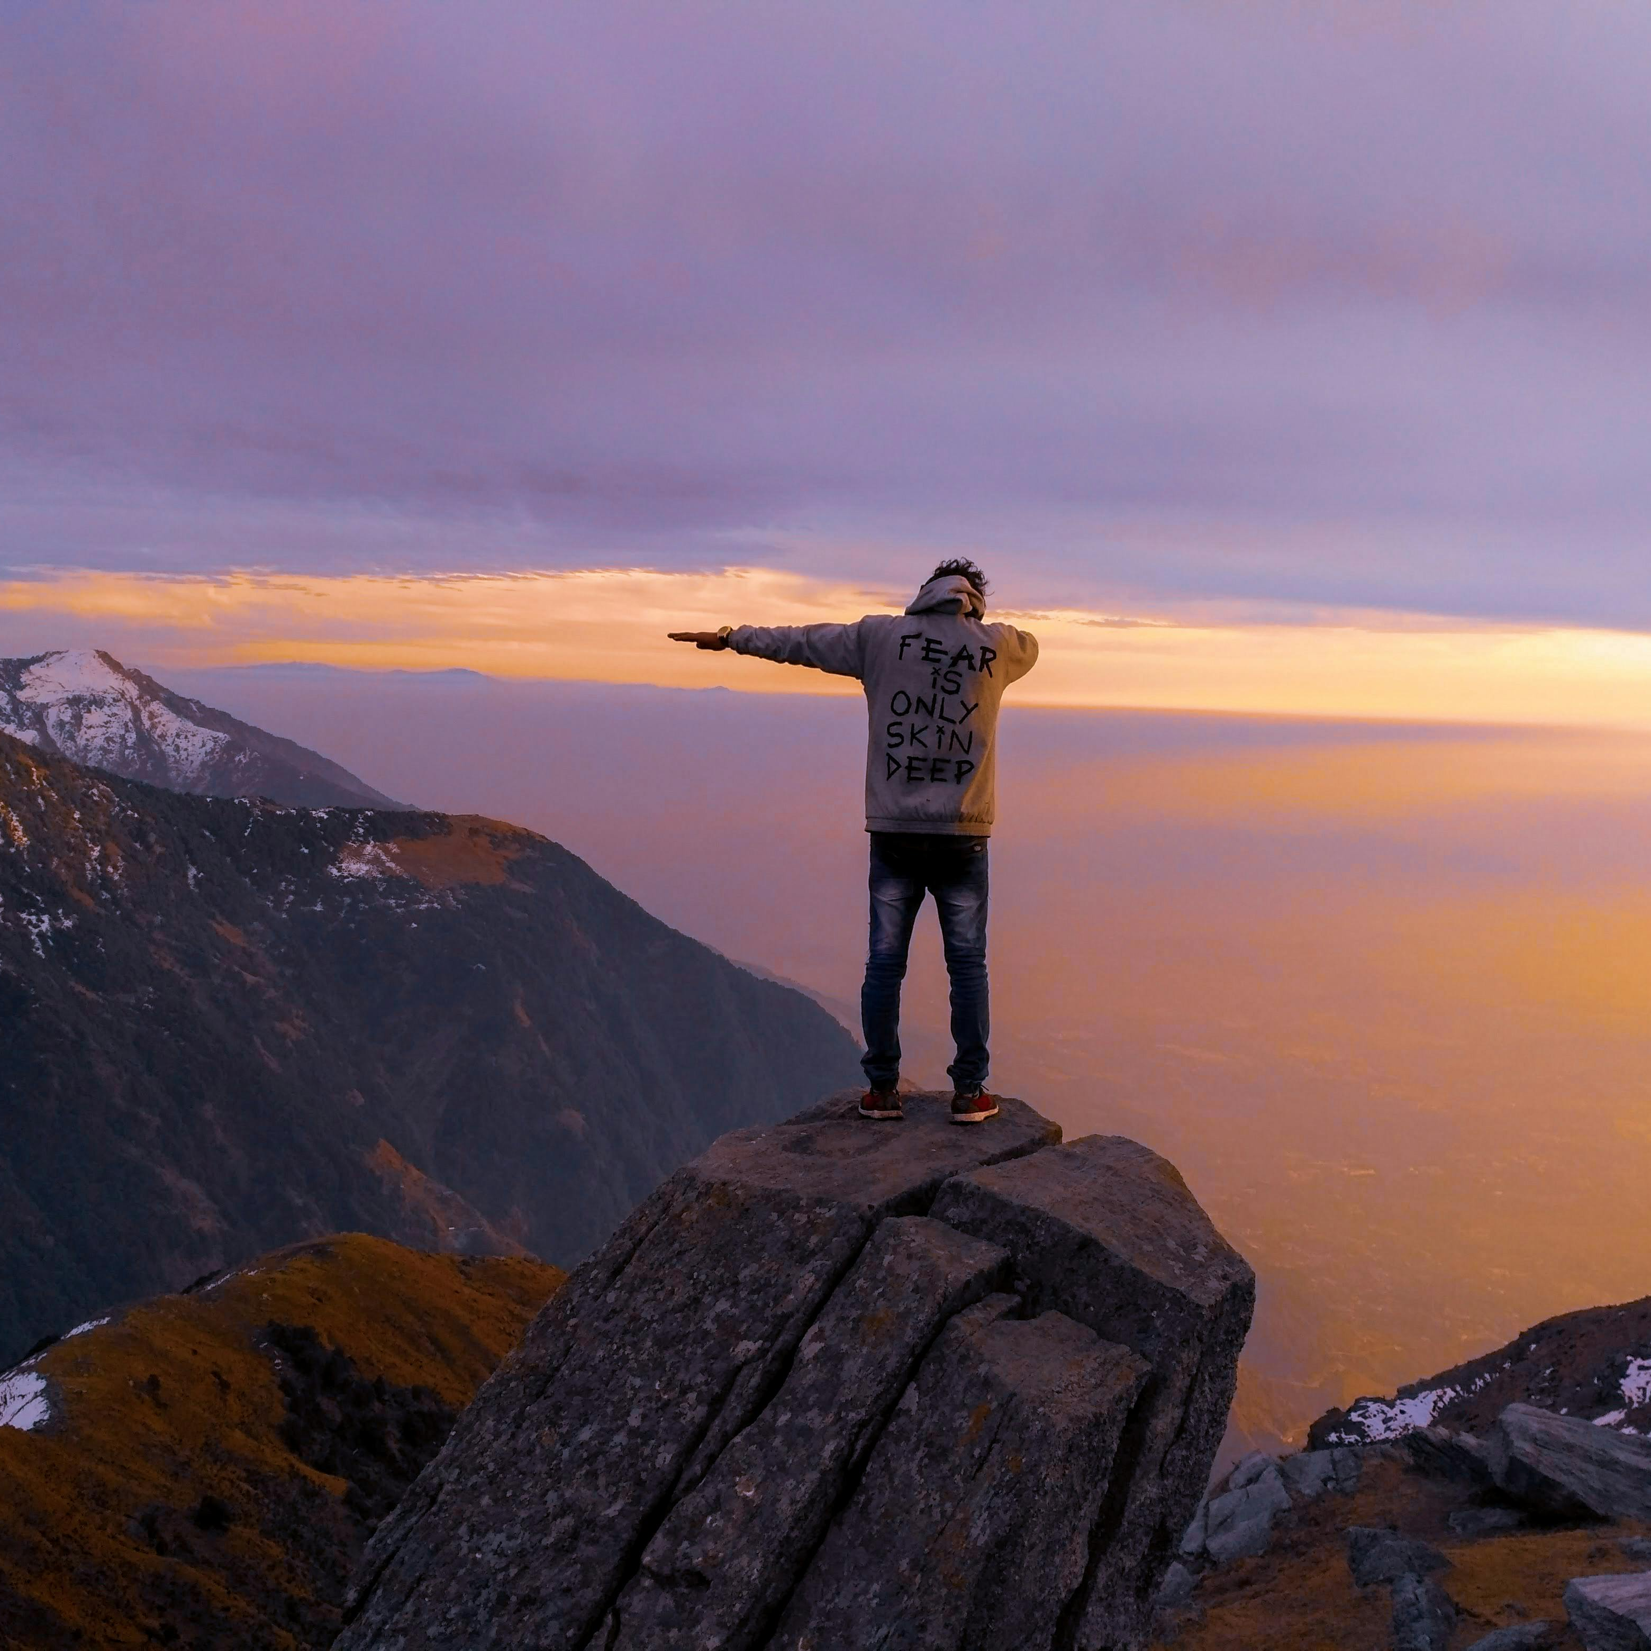
Physical Courage

Slide 13
“moral courage involves facing the particular fears and dangers arising from the possibility that one will be punished (broadly speaking) for taking a moral stand”
Matthew Pianalto. “Moral Courage and Facing Others.” International Journal of Philosophical Studies 20 (2012): 167.

Slide 14
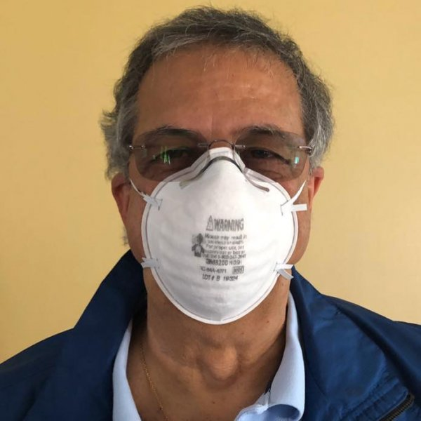
Moral Courage
This Photo by Unknown Author is licensed under CC BY

Slide 15

Courage Is Compatible with (Some) Fear
Some fear is better than none, if a lack of fear makes you reckless.

Slide 16
Moral Courage Is NOT Compatible with Treating People as Mere Objects or Obstacles
(as some fanatics do).

Slide 17
Venn Diagram with Physical, Moral, and Environmental Moral Courage (not to scale)
Physical Courage
Moral Courage
Environmental
Moral Courage
Definitely not to scale

Slide 18
Moral courage, environmental style, requires that you face the possibility of danger or punishment because you take a stand for a specifically environmental good or right (or against a specifically environmental harm or violation of a right).

Slide 19
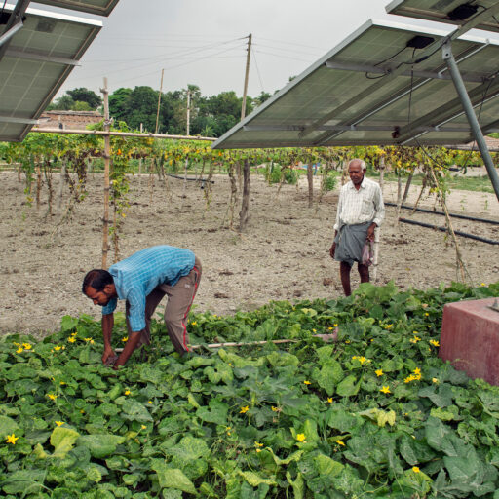
Environmental Moral Courage
This Photo by Unknown Author is licensed under CC BY-ND

Slide 20
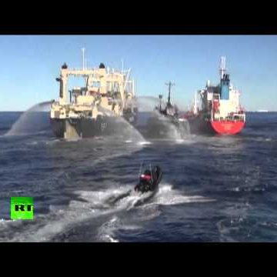
Physical Courage
& Environmental Moral Courage
This Photo by Unknown Author is licensed under CC BY-NC-ND

Slide 21
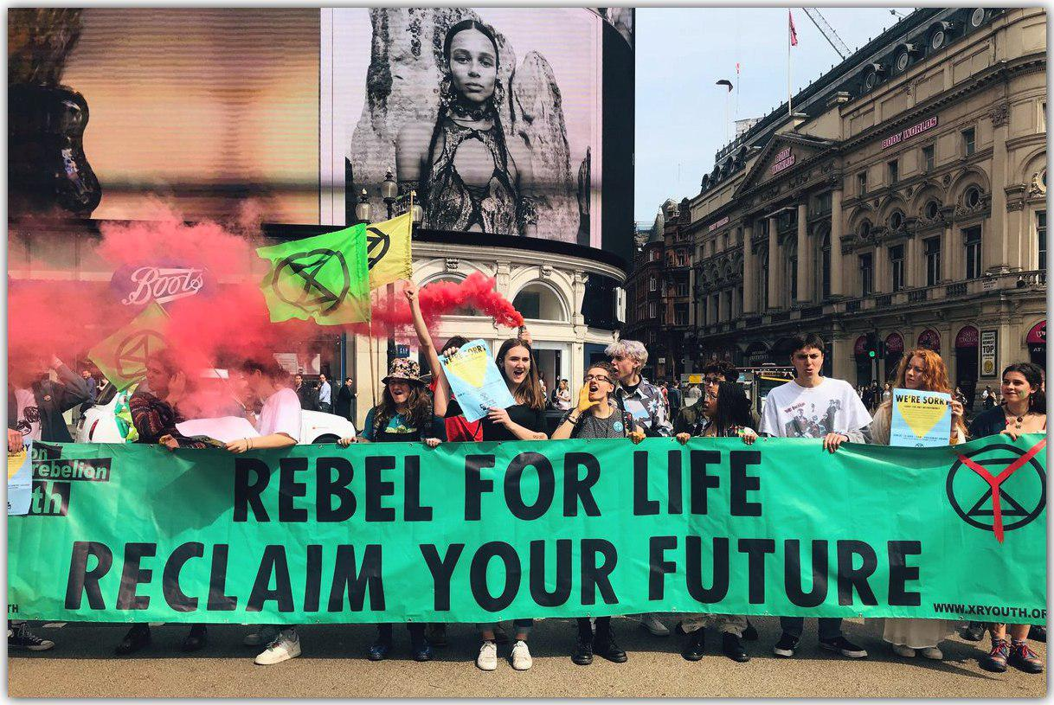
Increased Recognition of Environmental Moral Courage Could Have Some Advantages
It could:
Illuminate the high stakes of some environmental activism/advocacy,
Undermine inaccurate and negative stereotypes of environmentalists, and
Help to de-militarize the concept of courage.
This Photo by Unknown Author is licensed under CC BY-SA-NC

Slide 22

How could you start being more environmentally morally courageous in your life?
This Photo by Unknown Author is licensed under CC BY-SA-NC

