Slide 1
Sustainable Practices in Your Community
A workshop in conjunction with
Philosophers for Sustainability
ISHPSSB Off-Year Workshop, June 2022
Hosted by Amanda Corris and Kaitlin Pettit
Notes:
(Introduce self, why you want to hold this workshop)

Slide 2
Philosophers for Sustainability
A growing global network of philosophers in all subfields, working together toward sustainable practices within and outside philosophy
2 years strong
150 philosophers in 17 countries
Sustainable Practices Guidelines for philosophers, now adopted by the APA
Monthly forums on topics like racial justice, teaching, advocacy, e-conferencing, and public philosophy
Advocacy teams focused on teaching, climate strikes, e-vents, social media, public philosophy
Conference in June 2021 on Philosophy and the Climate Crisis
@phil4sustain
philosophersforsustainability@gmail.com
www.philosophersforsustainability.com
Notes:
Philosophers for Sustainability is a group of philosophers that aims to encourage our profession to take leadership on climate change and environmental sustainability.
It was founded by Rebecca Millsop at the University of Rhode Island and Eugene Chislenko from Temple University
Our first project was to write the Sustainable Practices Guidelines (link in the chat). We successfully lobbied to get those adopted by the APA, which means they are now official recommendations for all American philosophers.
We’re currently working on building up our Sustainable Practices Workshops like this one, and have offered them at many different departments and conferences in several countries. Our goal is to make workshops like these accessible for interested people to host at their own departments, and so build a grassroots movement for more sustainability in philosophy and in academia more broadly.

Slide 3
Goals of this workshop
To report on some recent efforts toward sustainable practices
To identify and discuss next steps in shifting our field (and the world) toward sustainable practices
Notes:
Today in this workshop, we’re going to talk about some recent changes Philosophers for Sustainability are helping bring about, as well as some next steps that we can take here as individuals and as part of our communities to help us be more sustainable.

Slide 4
In the chat:
Brainstorm one thing you’d like to get out of this workshop.
Notes:
Let’s get more specific than that, though. I want to know what each of you want to get out of this workshop. In the chat, would you post one specific thing you’d like to get out of this workshop.
For examples, you can look to the Guidelines for Sustainable Practices (put link in chat).
This can start with individual goals, like becoming better educated on sustainability in general or on a particular aspect of sustainability, or you can think of a broader goal, like something you’d like to see your community or department do. They don’t have to just be goals you’d achieve in the next hour, you may also be interested in continuing this conversation on or in seeing some next steps put into practice.
Examples: find sustainability resources on campus, get ideas for how to bring environmental awareness into courses that aren’t just environmental ethics, learn more about environmentally friendly transportation options

Slide 5
Global interest in sustainability
Notes:
Let’s go over a bit of background before we jump into brainstorming ways to fulfill those goals.
Globally, there’s been surging interest in more sustainable measures, as we saw with the international meeting in Glasgow last fall.

Slide 6
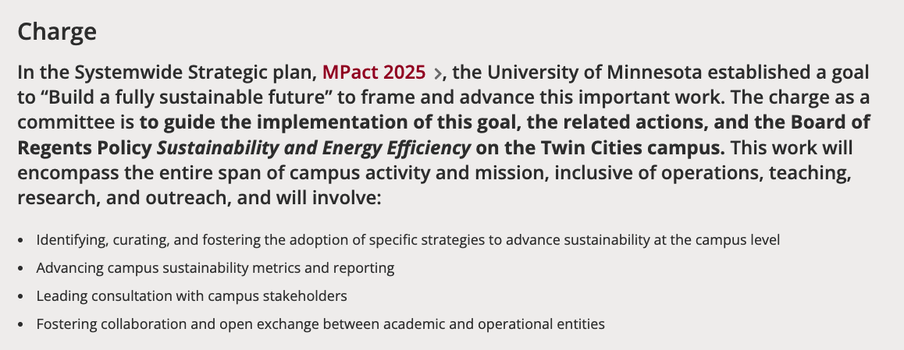
Local interest in sustainability
Check out your home institution’s or organization’s website for your own local commitments!
Notes:
We’re also seeing increasing interest in sustainable practices at individual universities. Here at the University of Utah, we are a part of the President’s Climate Leadership Commitments, which means that we are working towards being carbon neutral as a university by 2050. Our current next step on that path is to create a new Climate Action Plan and submit a greenhouse gas inventory for campus by May of 2023. We also evaluate our progress towards our goal of carbon neutrality annually.
At the University of Minnesota: Institute on the Environment (very active, big talks/events with climate leaders, lots of partnerships); ACARA leadership program (opportunities for grad students, also funding for projects), sustainability education focus with courses, events, groups, etc. It All Adds Up is UMN’s sustainability campaign. “The University is working toward net-zero carbon emissions by 2050. In 2019, 41% of our electricity came from renewable sources, and our emissions have been reduced 37% since 2011”
If you dig into it, many of your own institutions may have similar commitments.

Slide 7
Roles for each of us
in securing a sustainable future
Many of us are trained in critical thinking, facilitating discussion, and organizing events (and people): all things that are needed for responding to climate change.
We can use our expertise and our positions within our institution or organization and within our communities to shift the field and the world toward sustainable practices.
We are in a good position to make an impact!
Notes:
As academics and researchers, we are in a unique position to make a difference here. We have a chance to use our unique skills to influence the way our institutions address climate change, as well as to guide our students in considering these issues. Climate change affects a lot more than just science and the future, we can bring in discussion of climate change issues into just about any course or area of our lives.

Slide 8
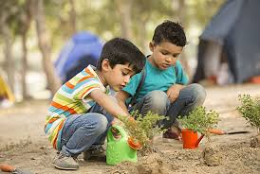
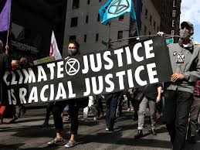
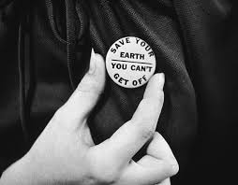
In the chat:
Share an area of interest in sustainability or one way sustainability issues impact your life right now.
Notes:
Let’s bring this even closer to home: in the chat, post one reason why the issue of sustainability or climate change matters to you, either as an individual or in your professional role.

Slide 9
Lessons and challenges
#1: There are a lot of low-hanging fruit.
Strategies:
A spark of leadership starts a new task force or student organization, introduces a new course, or cancels 500 beef sandwiches for an event
Notes:
Climate change can feel like a daunting problem for many people (environmental activists included!), so it can help to start out by brainstorming some potential actions we can take.
First the challenges: Many of us are concerned about climate change and are interested in contributing, but aren’t sure where to start. The good news is, it can take just a small show of initiative from any one of us (or even better, from each of us!) to help set things in motion. We can talk about some of these first steps we can take in breakout rooms in just a minute.

Slide 10
Lessons and challenges
#2: Everyone is scared, overworked, and burned out.
Strategies:
Focus on integrating climate change into existing research, teaching, and service, rather than adding
Encourage claiming academic CV credit for participation in sustainability initiatives
Lead with kindness: no hate and no guilt trips, including toward yourself
Notes:
It’s also easy for us to feel overwhelmed in the face of such a massive problem like climate change. I’m here talking to you about it, and there are definitely times when doubts still crop up in my mind, and I’m sure you’ve all faced similar anxieties. Here again, small steps can help us: we can focus on how to incorporate sustainability initiatives into our existing daily routine, rather than trying to make radical – and sometimes exhausting – change. The biggest thing we can do here is acknowledge that we are all trying, and that that is what matters. As long as we’re trying to make the world better, we’re on the right path.

Slide 11
Lessons and challenges
#3: People have very different kinds of interest, access, and ways of having an impact.
Strategies:
Facilitate collaborative discussion with attention to individual situations
Use sustainability guidelines as a starting point, to offer many options at different scales
Notes:
Finally, we have to take into account that not everyone is coming at this problem in the same way or with the same background. Talking to each other like we’re about to do can help us see where everyone is coming from and have compassion for that. It can also help us highlight the strengths we each bring to a discussion like this, and learn how to use those strengths.

Slide 12
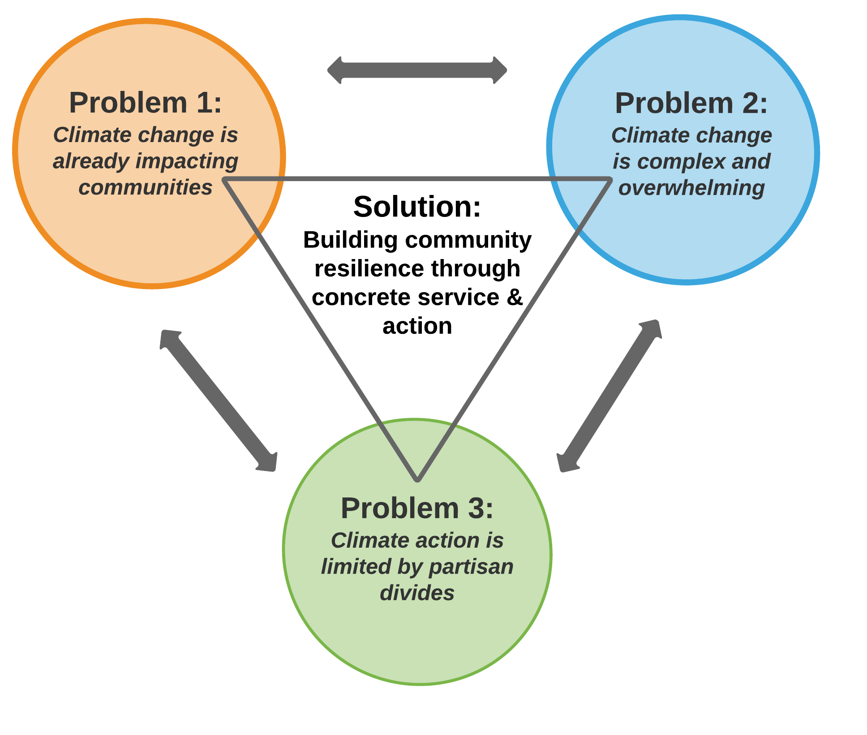
In the chat:
https://www.climatecrew.org/why_we_do_it?locale=en
Share a difficulty you’ve faced when discussing climate change issues.
Notes:
Let’s focus in on this: in the chat, post one difficulty you see when discussing issues of climate change. This can be logistical - like how to go about funding a virtual conference or a way in which climate change is making your research more difficult - or more of a meta concern, like communicating with people who are resistant to your message or the existential anxiety you feel when talking about climate change.

Slide 13
Possible next steps (collective)
Coordinated advocacy campaigns
For large conferences to become or remain virtual post-pandemic
To support climate strikes
To adopt guidelines
A wave of sustainable practices workshops
Give yourself a high five already!
Do you want to host one at a conference?
Further events, collaborations, and gathering/creating/sharing of resources
Create a task force on incorporating environmental discussions into non-environmental ethics courses
Begin to form local chapters, with specific local advocacy goals
Advocate for departmental- or university-level change
Notes:
So how can we address those challenges? As a community of scientists and researchers, either in our individual departments or more broadly, we can help bring attention to this issue and be part of the solution. We can participate in climate strikes and encourage others to do so. We can advocate for virtual or hybrid conferences and colloquia, which have the added bonus of being more inclusive to all philosophers. If you’re interested, you can host a workshop like this one at a conference you’re going to, we have resources (including these slides) up on our website to help you organize that. And we can work to incorporate sustainable action in our department and our university at large.

Slide 14
Possible next steps (individual)
Integrate climate change & sustainability into your
professional role
Teaching
Research
Service
Read and implement some sustainability guidelines
Link on invitation email
www.apaonline.org/page/ goodpracticesguide <- Section 9
Tell us about your initiatives and have us advertise them for you
philosophersforsustainability @gmail.com
Suggest, join, and/or lead a monthly forum with PfS
Racial Justice
Political Action
Teaching
E-Vents
Public Philosophy
Notes:
There are also things we can each do on our own that will help. Climate change brings up so many philosophical and scientific issues that discussion of it doesn’t just belong in environmental ethics classes. We can use climate change as an example in class when we’re talking about rational choice theory, or human psychological reactions to distant problems, or corporate ethics. We can also keep sustainability initiatives in mind when we’re planning events: are there other, more sustainable, options that would help us achieve the same goal? If we’re providing lunch, we could opt to make that lunch vegetarian. If we’re bringing in a speaker, they could give a virtual talk rather than fly into town. Even as we’re researching our own niche topics, sustainability issues often intersect with our own interests.
If you’re interested in learning more about Philosophers for Sustainability, our monthly forums are a great place to jump in. You definitely don’t have to be a philosopher to join! We cover a wide range of topics, so likely one you’re passionate about has or is about to come up. We’re also happy to provide free advertising for any sustainability initiatives you already have going on. If you’re publishing an article or blog post, or doing an interview, that intersects with sustainability, please send it to us and we’ll help draw more attention to it!

Slide 15
Guidelines for Sustainable Practices
Events
Food
Minimize food waste and packaging
Reduce carbon-intensive foods
Consider distribution factors
Conferences and Travel
Encourage virtual or hybrid options
Invite local speakers
Consider carbon offsets
Facilities
Construction
Disposal of equipment
Reusable options
Teaching and Research
Course Content
Show relevance to students’ lives
Consider as a core requirement
Incorporate small components
Course Methods and Policies
Invite guest speakers from campus
Apply content to own lives
Utilize electronic options
Advising
Be aware of environmental anxiety
Don’t avoid difficult conversations
Research
Consider climate connections
Take leadership
Interdisciplinary collaboration
Governance and Public Advocacy
Consider environmental impact
Incorporate into mission statement
Collaborate in advocacy efforts on- and off-campus
Notes:
Philosophers for Sustainability has compiled a set of Guidelines for Sustainable Practices that help make these ways we can make a difference more concrete. We’ve broken it down into eight categories. When you’re planning an event, you can consider the environmental impact of the food you choose to provide. You can limit this by minimizing food waste and packaging, choosing local products or a plant-based menu, and by taking into account how the food is sourced and distributed. When planning an event, you can also consider how the travel you’re incurring will affect the environment. If possible, you can opt for a virtual or hybrid approach. When that’s not possible, you can seek out local options, either in the conferences you attend or the speakers you invite. Barring that, you can look into whether your department is willing to pay for carbon offsets. If you’re hosting an in-person conference, you can highlight public transportation options and nearby hotels and restaurants to help participants minimize their travel. Finally, we often have the chance to have input on how facilities are handled at our institution. This might be something as big as the construction of a new facility or the disposal of a retiring one, or something as small as advocating for reusable options in your departmental break room.
When we’re teaching, it’s important to relate the content to students’ lives. This helps them connect better with the material and take action going forward. If you’re in the position to do so, you can consider whether something like a climate impact or environmental ethics course would be a candidate or a core requirement for your undergraduate or graduate degree. You can also approach this at a much smaller scale: because of how wide-reaching issues of climate change are, they provide good examples in a variety of courses. This can help reach a broad range of students and encourage thinking about the impacts of sustainability in many contexts. When we’re creating a course, it can be helpful to bring in speakers from other departments or advocacy groups in the community. Assignments that ask students to relate the course content to their own lives are also often better at measuring content comprehension and retention than multiple choice or short answer tests. We can also design our courses to produce as little waste as possible by utilizing electronic options for assignments and assigned readings. When we’re advising students, we want to be sure to help them address any environmental anxiety they may be feeling, while making sure not to act as their therapist. When appropriate, we can refer students to the counseling center.
In our research, as in our classes, it’s important to consider climate connections and examples that we might not ordinarily make. Again, the wide-reaching effects of climate change mean that it affects many more disciplines and topics than we might first assume. This can be especially helped by interdisciplinary collaboration.
Finally, many of us may find ourselves in a position to give advice on a broader scale than just in our own classes or research. In each policy decision that we make, we should consider the environmental impact. When appropriate, this focus can be incorporated into a mission statement or departmental policy. It’s helpful to make the rationale behind policies clear, and part of this may be explaining the need for a focus on sustainability.

Slide 16
Before we chat:
Write down:
One collective next step you’d like to see toward sustainability in your community
One individual next step that might be interesting and doable for you
One challenge you’d like to discuss
Notes:
Let’s move on to the breakout rooms so we can talk more about this. While I’m getting those set up, write down on your own one collective next step you’d like to see in your community, one individual next step that you could take now, and one challenge you’d like to bring up. If you need some ideas, check out the Guidelines for Sustainable Practices that are in the chat.

Slide 17
In the chat:
Discuss:
One collective next step you’d like to see toward sustainability in our community
One individual next step that might be interesting and doable for you
One challenge you’d like to discuss
Notes:
(After ~1-2 minutes of silent brainstorming, open up breakout rooms for participants. Encourage them to share what they wrote down. Aim to have these breakout rooms open for 5-10 minutes.)
(As everyone comes back from the breakout rooms, ask someone from each room to share some of the ideas they discussed.)
(After about 10 minutes of this brainstorming, focus in more on ways that the field or individual departments could act on or support the recurring ideas that you’re focusing on.)
(After about 10 minutes, narrow in on concrete actions you can take.)

Slide 18
In the chat:
Brainstorm one next step you’d like to take after this workshop.
Notes:
Thanks for being so involved in that great discussion and for all your wonderful ideas! As a closing exercise, would you post in the chat one more time one next step you’d like to take. This can be leading a workshop like this one at your home institution or starting a petition to enact one of the changes we talked about, making a change in your own life, or a specific way you want to incorporate sustainability concerns into one of your classes.

Slide 19
Philosophers for Sustainability
Thank you!
@phil4sustain
philosophersforsustainability@gmail.com
www.philosophersforsustainability.com
Notes:
Thank you for coming! If you have any thoughts you’d like to share, you can send those to Philosophers for Sustainability at the email above, we always love to hear your feedback.

